Slide 1
Lecture #2:
Aggregate Composition
and Grading

Slide 2
Aggregate Uses
Rock like material that has many
Civil Engineering applications:
Road bases and fills
PCC: 70%
AC: 90%
Ballast for railroads
Foundations
Plaster, mortar, grout, etc.

Slide 3

Considered to be inert, inorganic material
  1) Naturally occurring:
  a) Gravels & Sands
  b) Crushed
  Washed and Sieved (Graded by
  size)
  2) Normal Weight - BSG 2.6
  3) Light Weight
  a) Blast Furnace Slag
  b) Expanded Shale, Clay, or Slate
  4) Recycled Concrete

Slide 4
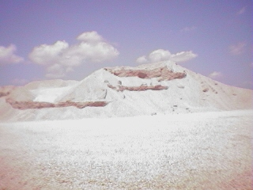
Use of Recycled or Aggregate Fines

Slide 5
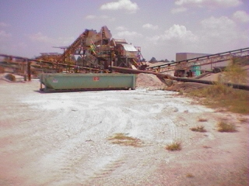
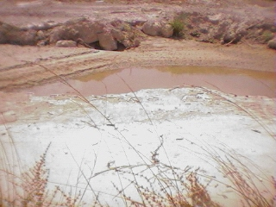
Washing and Waste

Slide 6
Aggregate Composition & Structure
Derived from rocks
Single or multiple minerals
3 Types: Igneous, Sedimentary, & Metamorphic
can be defined according to:
  1) Chemical and mineral composition
  2) Internal structure
  3) Texture

Slide 7
Aggregate vs. Rocks and Minerals
Aggregate - fragments of naturally occurring rocks
Rock – combination of one or more minerals
Mineral - are naturally occurring inorganic
substances of more or less definite
chemical composition and crystalline
structure

Slide 8
Rock and Mineral Identification
To help gain an appreciation for aggregate
characteristics and uses in certain applications.
Also to understand why some rocks and minerals
have desirable and undesirable characteristics
as potential aggregates.

Slide 9
Three Type of Rocks According to Their Origin
 | Igneous | Sedimentary | Metamorphic
Origin | solidification due to cooling from a molten magma | weathering & erosion of the pre-existing rocks | Transformation of the pre-existing by the process called metamorphism
Process | sequential crystallization of minerals from liquid with decreasing Temp. | accumulation and consolidation of the products of weathering and erosion | Transformation involves mineralogical, textural and structural change of the original rocks
Commonly used as aggregates | Granite, andesite, basalt, gabbro | Limestone, Sandstone, gravel | Marble, metaquartzite, gneisses, granulites

Slide 10
Minerals
Type of minerals | Name | Chemical formulae
Silica | Quartz, Chert, Opal etc. | SiO₂
Feldspars | Orthoclase Albite Anorthite | KAlSi₃O₈ NaAlSi₃O₈ CaAlSi₂O₈
Carbonate | Calcite Dolomite | CaCO₃ Ca,Mg (CO₃)₂
Ferromagnesian silicates | Pyroxene Olivine | (Fe,Mg)SiO₃ (Fe,Mg)₂SiO₄
Opaques | Magnetite Hematite Ilmenite | Fe₃O₄ Fe₂O₃ FeTiO₃

Slide 11
Aggregates are combination of Different Type of Rocks and Minerals
Sandstone (quartzite) – contains mainly quartz
Limestone – contains mainly calcite
Dolomitic limestone – 10-30% dolomite, 90-70% calcite
Gravels – accumulation of different rock types
SRG – mainly quartz-rich rock
CRG – mainly calcite-rich rock
Granite – contains quartz, feldspar, biotite,
amphibole, pyroxenes etc.

Slide 12
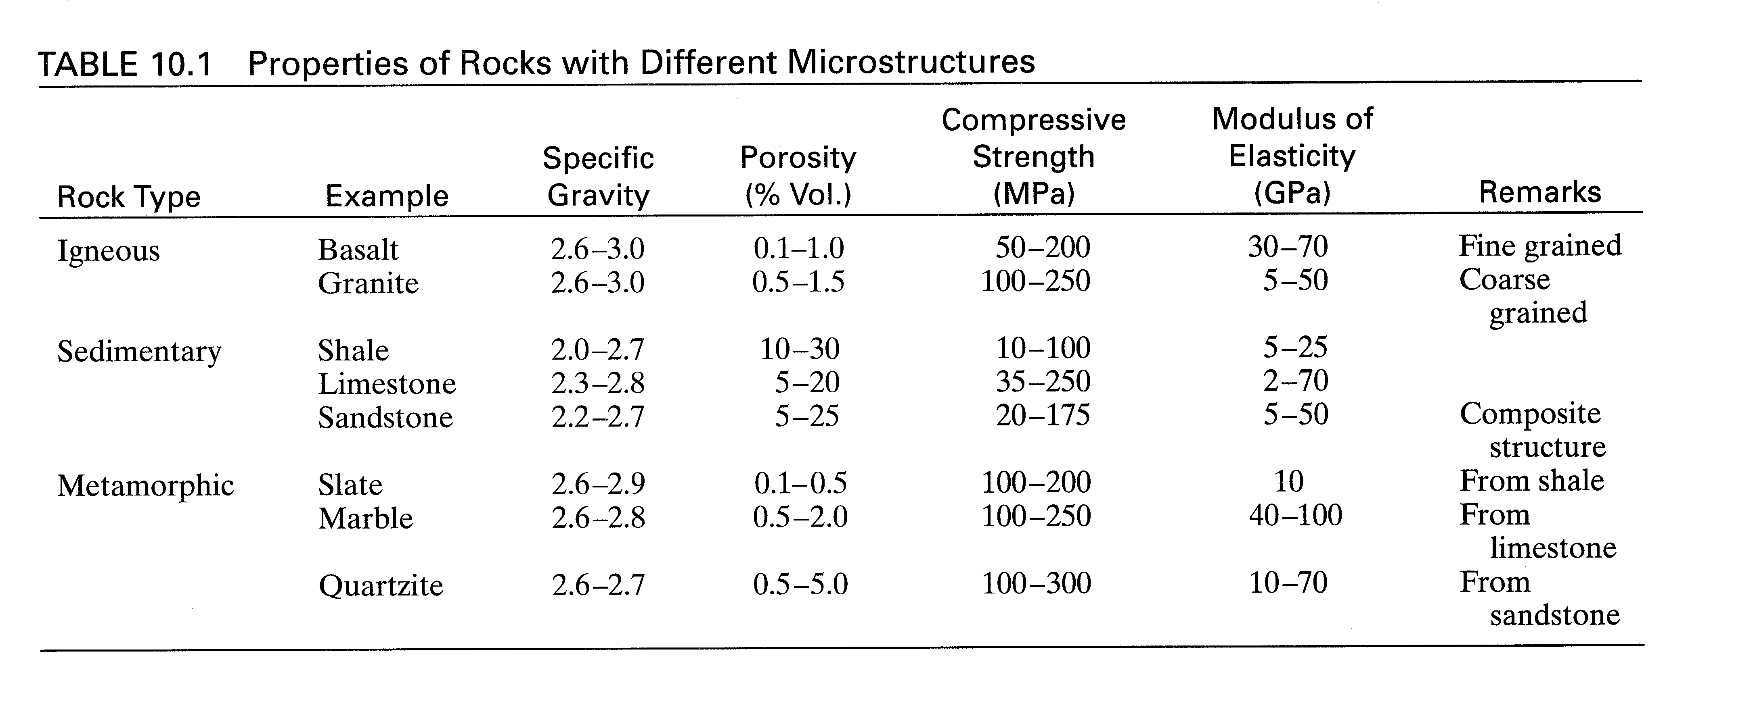
Properties of Rocks

Slide 13
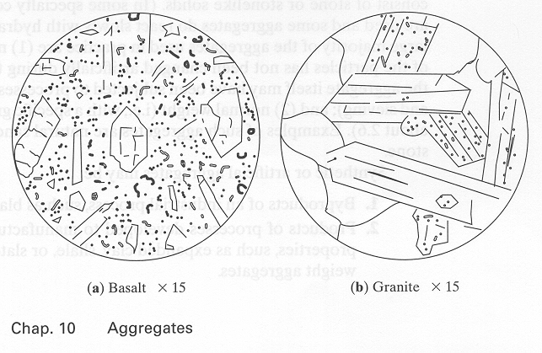
Igneous Rocks
Notes:
Igneous rocks are formed by cooling
Phase separation occurs: crystals or minerals form in a crystalline matrix
Rate of cooling determines crystal size
Fine grained crystals are stronger
Sedimentary rocks are formed by consolidation of deposits of weathering and erosion of existing rocks due to a reduction of porosity. These are weaker than igneous rocks.
Metamorphic rocks are formed by heat and pressure to sedimentary rocks due to re-crystallization.

Slide 14
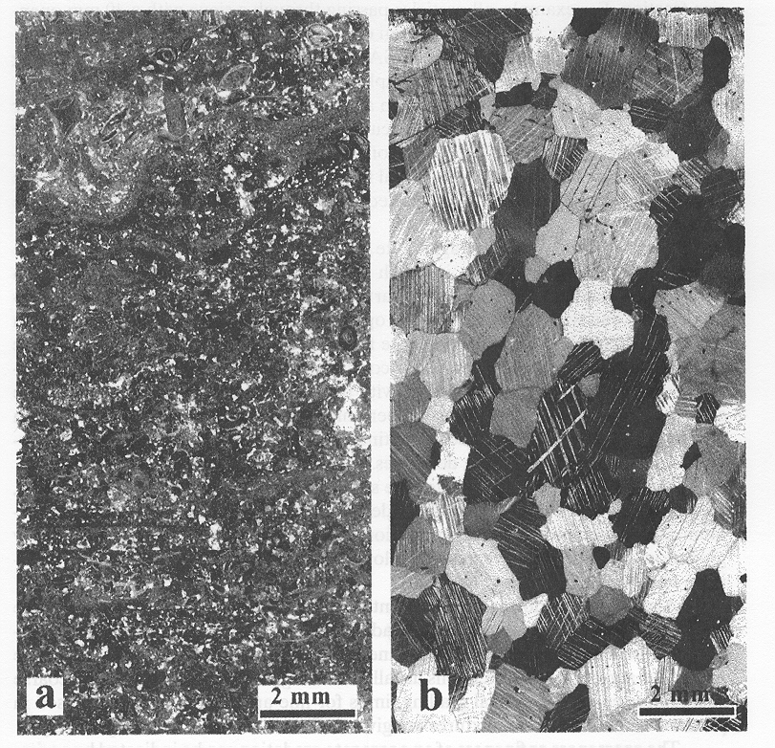
Sedimentary vs. Metamorphic
Marble
Limestone

Slide 15
Rock Identification
Hardness
HCI Reactivity
Cleavage
Other

Slide 16
Hardness
Based on Mohs hardness scale
Use a knife blade to scratch material
Use a mineral to scratch the testing
material

Slide 17
HCl Reactivity
Serves to differentiate the carbonate
minerals with react with HCl from other
mineral types.

Slide 18
Cleavage
On planes of breakage; a mineral may
contain one or more planes of cleavage
or none.
  Micas have cleavage in one direction
  Feldspars have two cleavage planes
at right angles
  Quartz has no cleavage but does have
a conchoidal fracture (shell like appearance).

Slide 19
Other
Color: Used as supportive evidence
Ability to Transmit Light:
Material may be transparent,
translucent, or opaque.

Slide 20
Crystal Properties
Structure - 3D network or lattice
Cleavage - between planes of most closely packed
Optical properties - refract/polarize
XRD
Symmetry

Slide 21
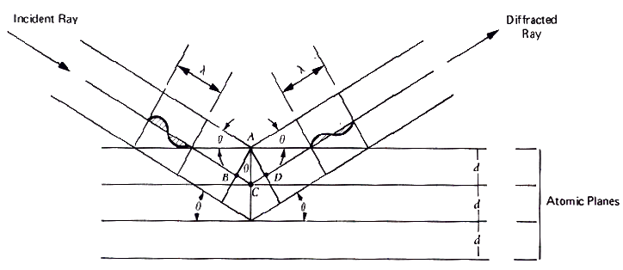
Braggs’s Law XRD

Slide 22
Bulk Chemical Analyses by XRF
Aggr. | No. | Bulk chemical analyses (wt%)
 |  | SiO₂ | Al₂O₃ | Fe₂O₃ | CaO | MgO | Na₂O | K₂O | LOI
SRG | 1 | 94.17 | 00.93 | 00.94 | 01.78 | 00.00 | 00.22 | 00.28 | 01.68
CRG | 3 | 35.57 | 01.20 | 02.30 | 32.20 | 01.50 | 00.00 | 00.30 | 26.46
Lst | 5 | 02.28 | 00.47 | 00.24 | 53.76 | 00.52 | 00.00 | 00.05 | 42.53
Sst | 12 | 79.84 | 08.43 | 04.51 | 01.09 | 00.85 | 01.43 | 01.95 | 01.67
Granite | 15 | 68.97 | 13.45 | 05.21 | 02.18 | 00.80 | 03.72 | 04.23 | 00.21

Slide 23
Properties of Aggregates
Physical
  Specific gravity
  Bulk density
  Porosity
  Voids
  Absorption
  Moisture
  Size
  Texture
  Shape
Mechanical
  Modulus of elasticity
  Compressive strength
  Shrinkage
  Chemical

Slide 24

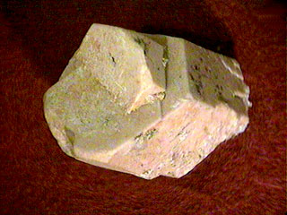

Indirect Measurement and
Correlation
Oxide Analysis
SiO₂
CaO
Fe₂O₃
  etc
Mineralogy:
Calcite
Dolomite
Hematite
Quartz
Feldspar
  etc
Mineral Constituents
Mineral CoTE

Slide 25
CoTE and MOE of Pure Minerals
Minerals | CoTE (10⁻⁶ / ºC) | MOE (x10⁶ psi)
Calcite | 05.58 | 20.42
Dolomite | 09.62 | 29.07
Quartz | 13.00 | 12.30
Microcline | 06.60 | 09.50
Albite | 06.52 | 10.50
Anorthite | 03.00 | 17.60
Magnetite | 06.86 | 38.30
Pyroxene | 12.11 | 32.50

Slide 26
Model for Thermal Expansion of Concrete
Parallel Model
Series Model
Composite Model

Slide 27
Serial Model
1/E= V₂/E₂+V₁/E₁
α_{c} = α₂V₂+α₁V₁
Mineral 1
Mineral 2

Slide 28
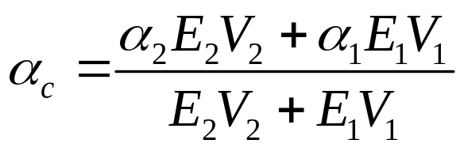
Parallel Model
Mineral 1
Mineral 2

Slide 29
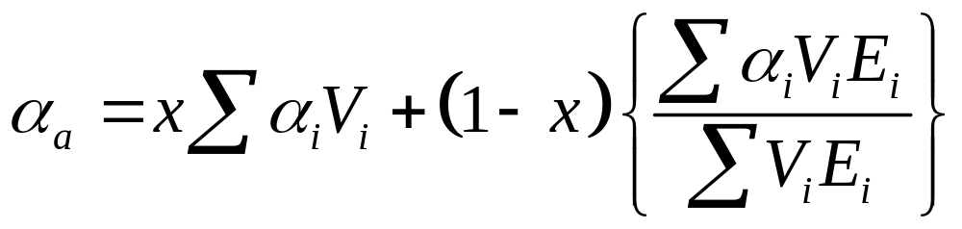
Hirsch’s Composite Model
Mineral 1
Mineral 2

Slide 30
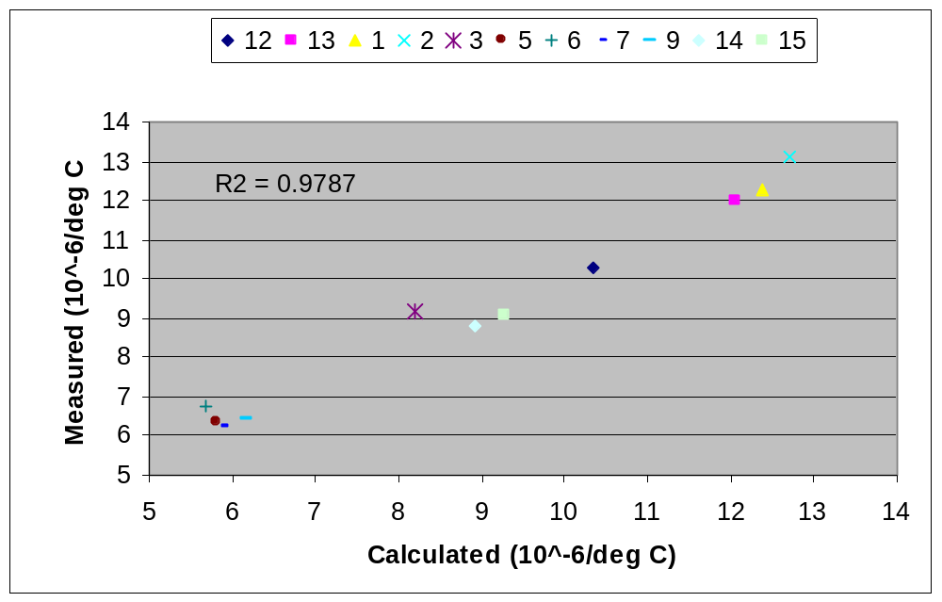
Validation of Aggregate CoTE Composite Model
Σστ
ΣΡΓ
ΧΡΓ
Γρανιτε
Λστ

Slide 31
Standard Size Groupings
Course aggregate
4.75mm to 50mm
Fine aggregate
0.075mm to 4.75mm

Slide 32
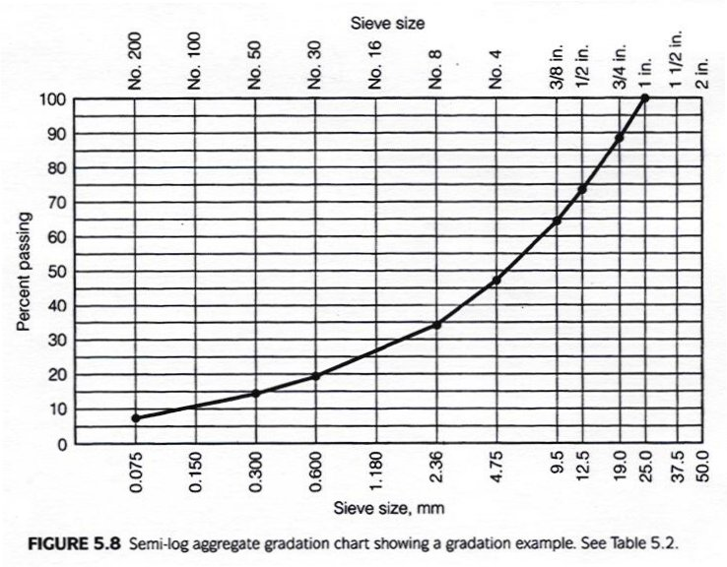
Gradation Chart

Slide 33
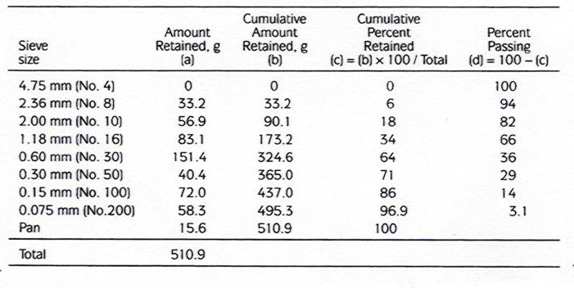
Gradation Chart Calculation

Slide 34
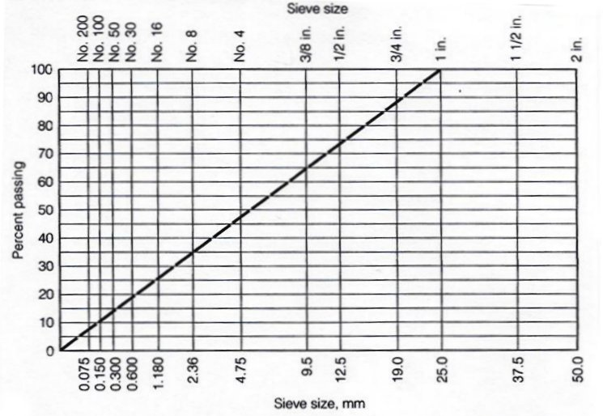
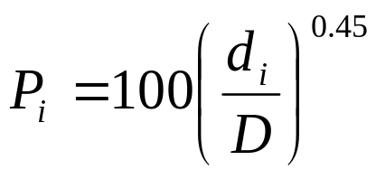
0.45 Gradation Chart

Slide 35
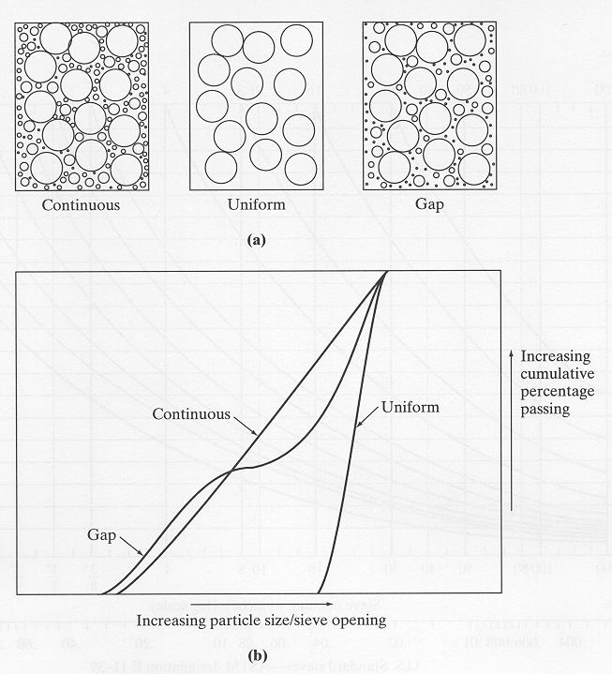
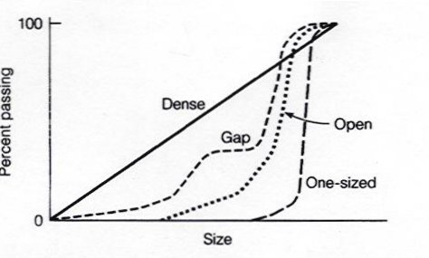
Aggregate Particle Size and Grading
Notes:
Distribution of particle sizes in an aggregate sample is called grading
Maximum size aggregate (MSA): smallest sieve opening through which the entire sample passes
Size fraction: d_{i} - d_{i-1}
Discuss the types of gradings.

Slide 36
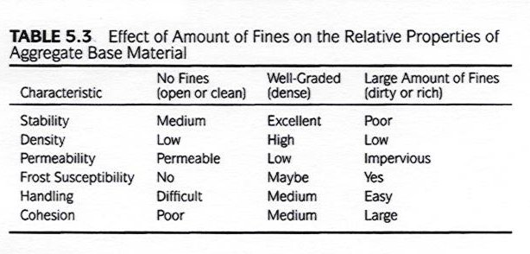
Effect of Fines in Mixture

Slide 37
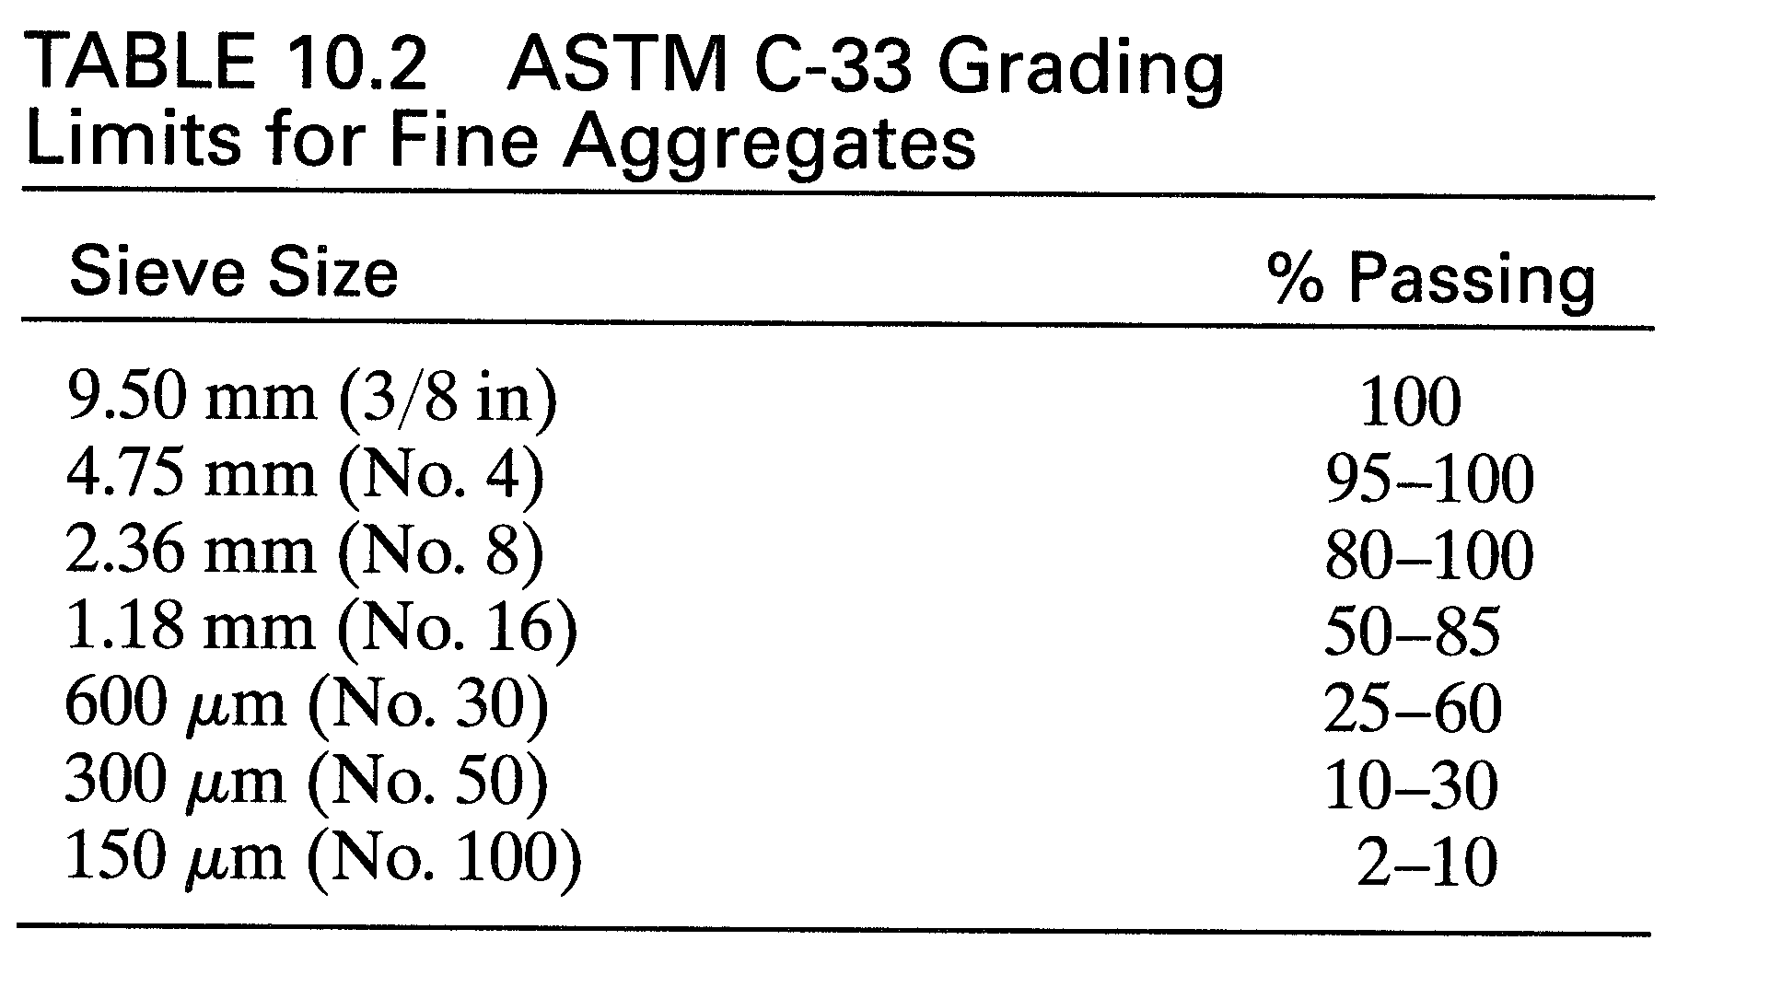
Grading Limits for Sand

Slide 38
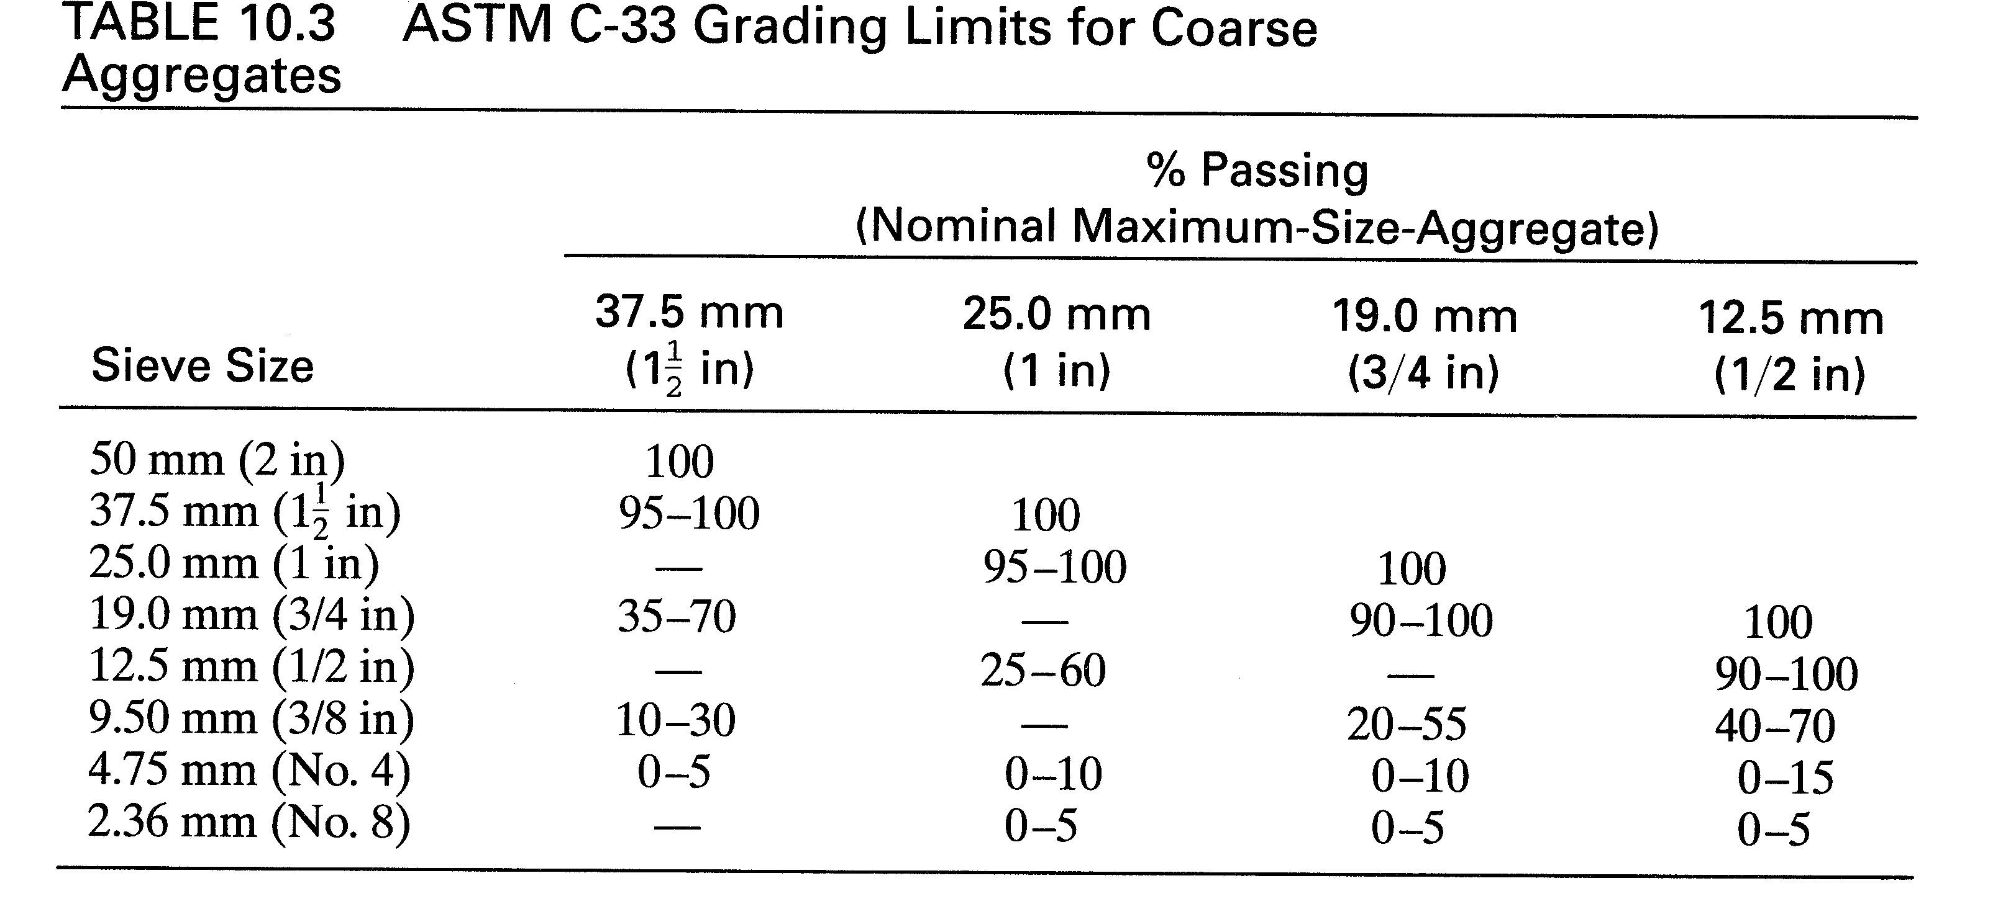
Grading Limits for Coarse Aggregate

Slide 39
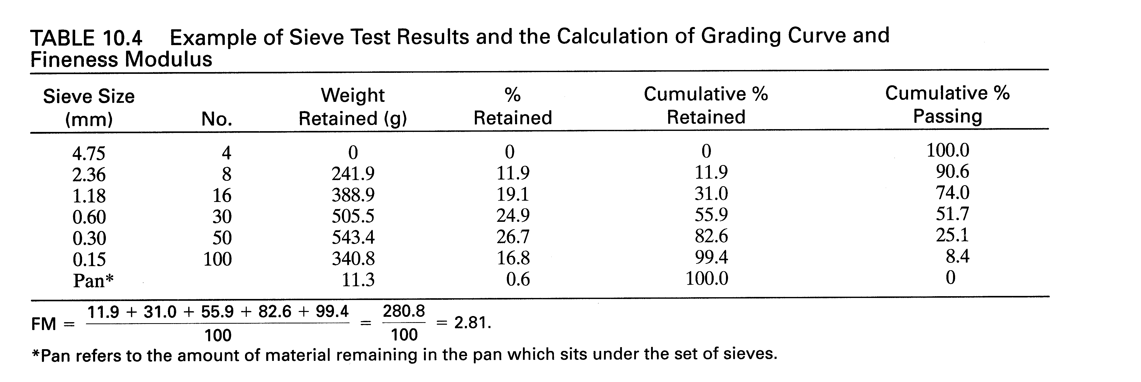
Calculation of Fineness Modulus
Notes:
Fineness Modulus requires the following sieve sizes:
No. 100
No. 50
No. 30
No. 16
No. 8
No. 4
3/8”
3/4”
1.5”
3.0”
6.0”

Slide 40
Calculate the Fineness Modulus
Sieve # | Wt Ret | % Ret | % Pass
1-1/2 | 0
3/4 | 300
3/8 | 1010
4 | 1320
8 | 1220
16 | 370
pan | 75
totals
Notes:
Fineness Modulus requires the following sieve sizes:
No. 100
No. 50
No. 30
No. 16
No. 8
No. 4
3/8”
3/4”
1.5”
3.0”
6.0”

Slide 41
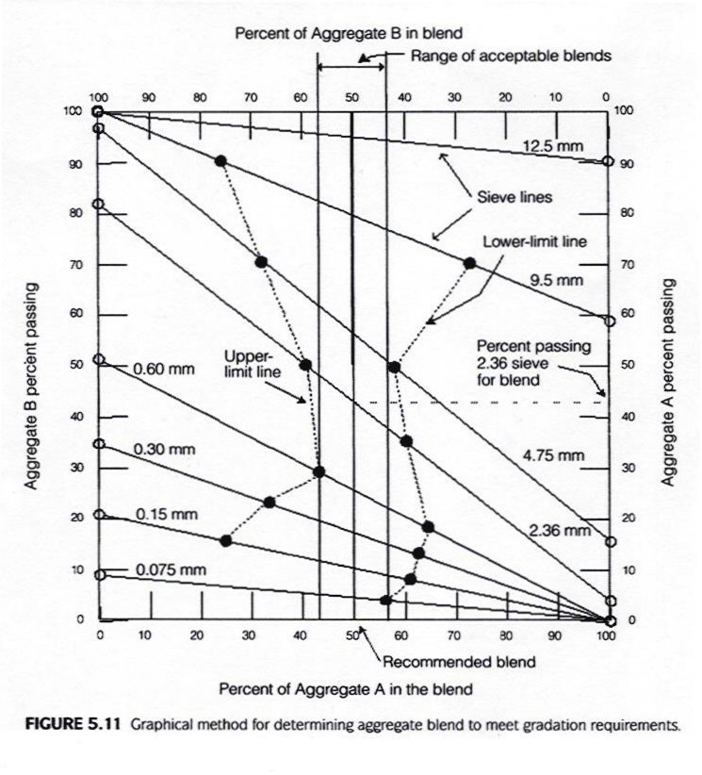
COE Method

Slide 42
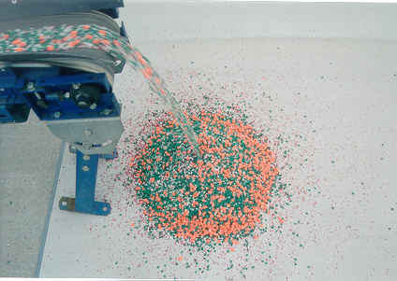
Aggregate Stocking Piling

Slide 43
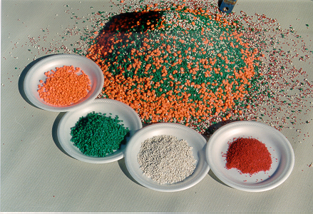
Aggregate Proportions

Slide 44
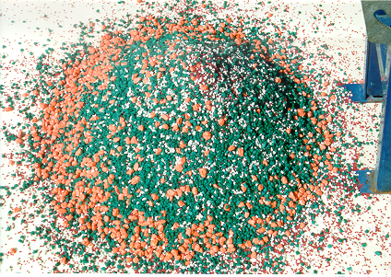
Stock Pile Segregation

Slide 45
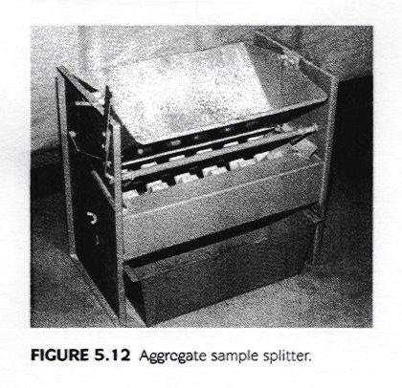
Fine Aggregate Splitter

Slide 46
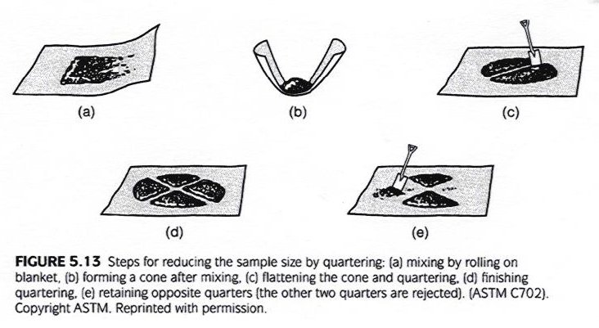
Aggregate Sampling

